Slide 1

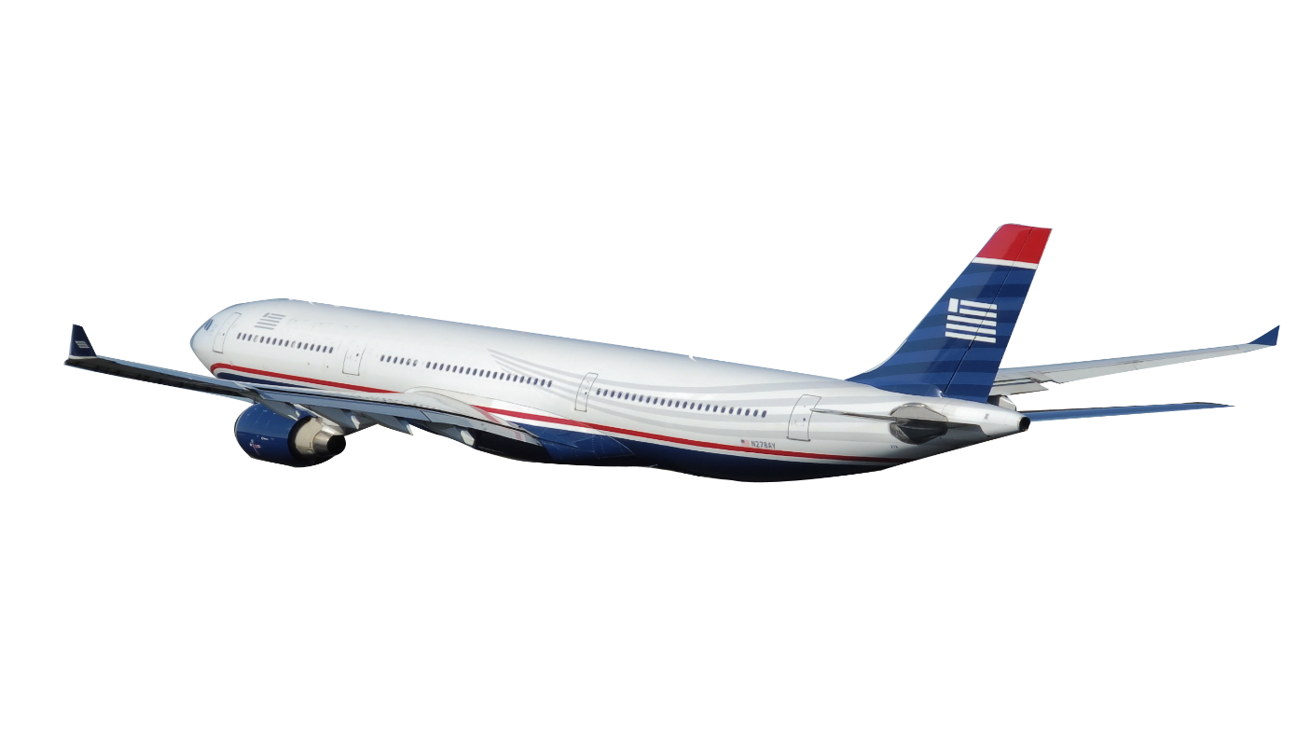
On Vacation !
When You Travel

Slide 2
Vacation
airplane
fun
hotels

Slide 3
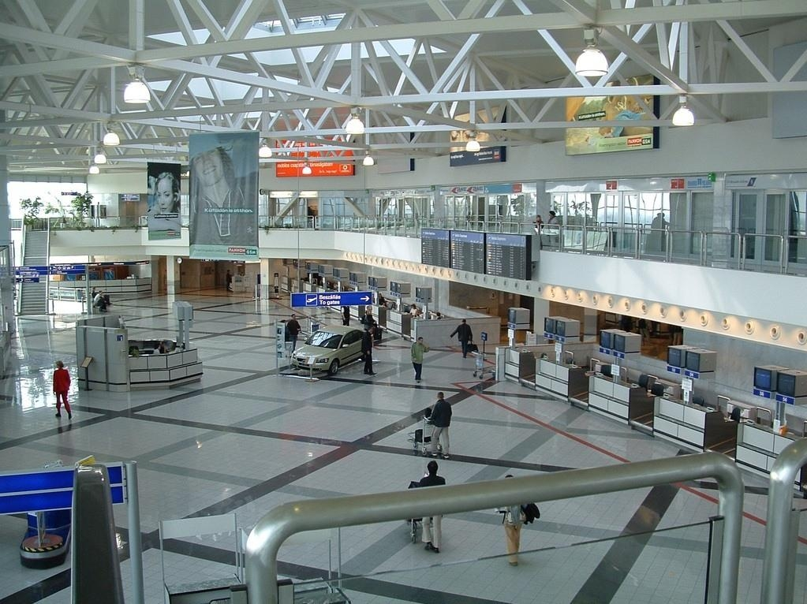

Slide 4
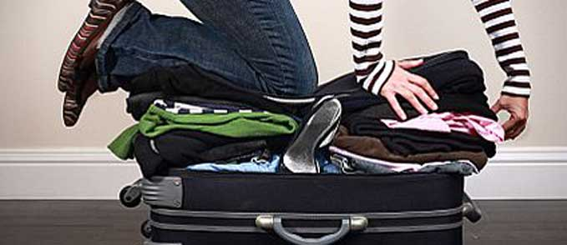
Packing her suitcase

Slide 5
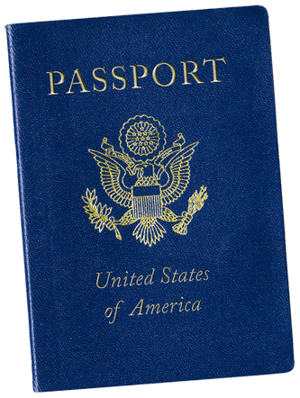
Get a passport

Slide 6
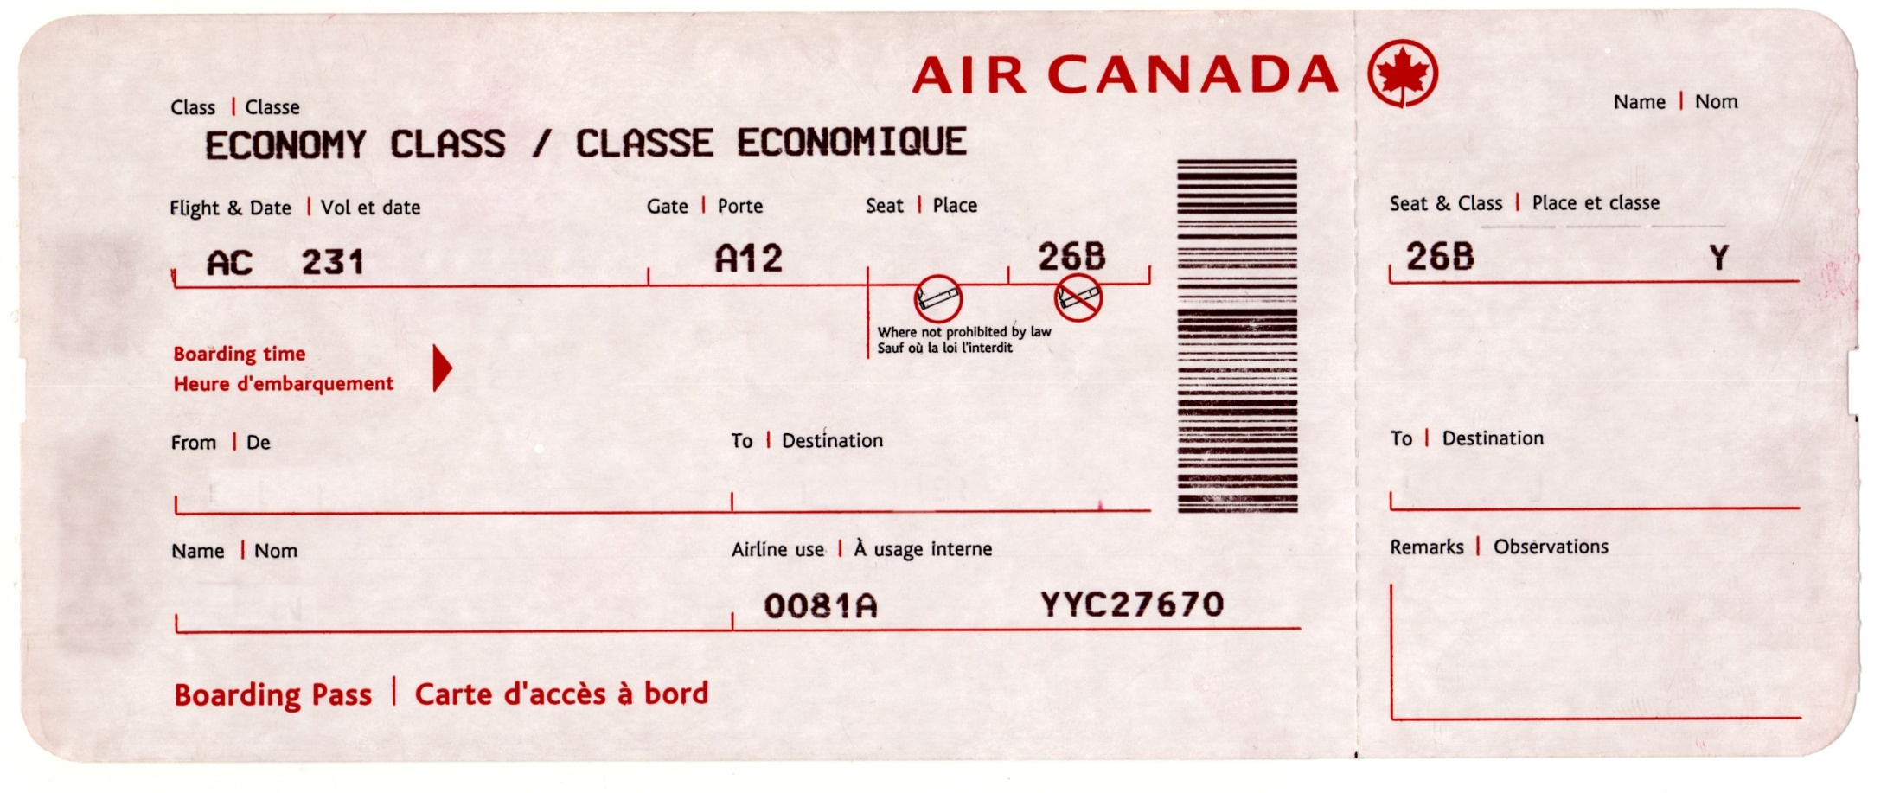
Buy a plane ticket

Slide 7
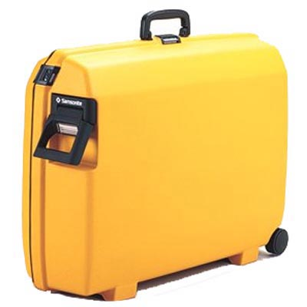
Buy a suitcase

Slide 8
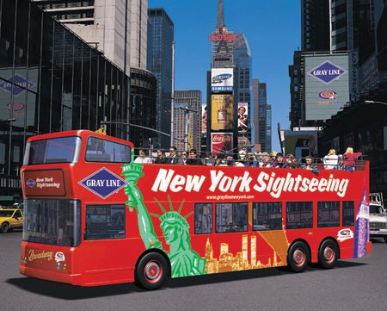
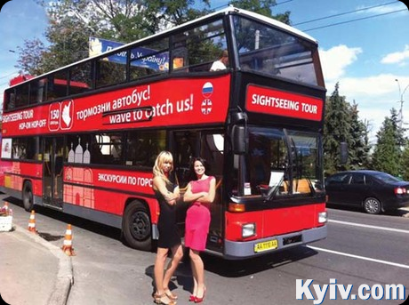
Go sightseeing

Slide 9

Rent a car

Slide 10
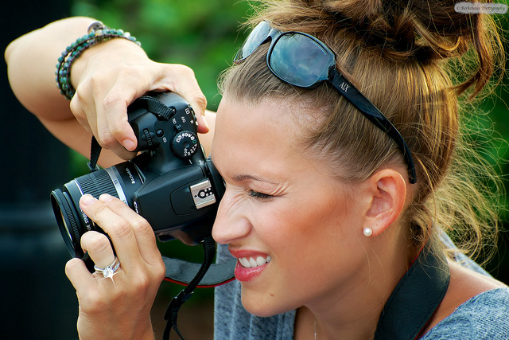
Take photos

Slide 11
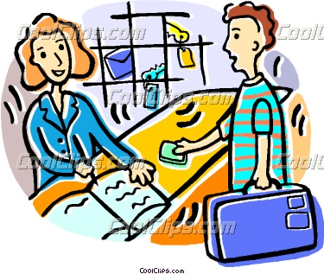
Check into your hotel

Slide 12
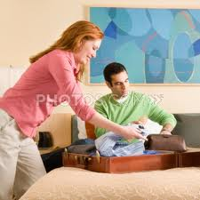
unpack

